Slide 1

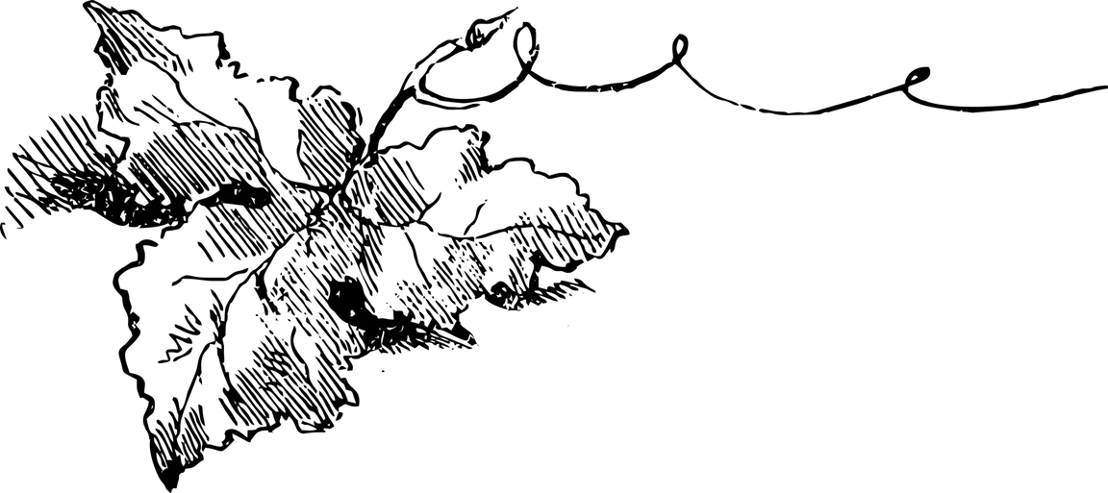
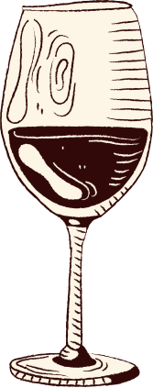

DataVine 12 Vineyard
Wine
Tasting
Our Vintners:
Alma Ontiveros, Charisse Robinson, Chorrkin Chin, Donald Sparks III, Erika Dorsainvil, Kidest Getahun, Magdalene Alva, Maya Morad, Mica Lorenzo, Mita Damte, Patrick Feeney, and Rob Jowaisas.

Slide 2
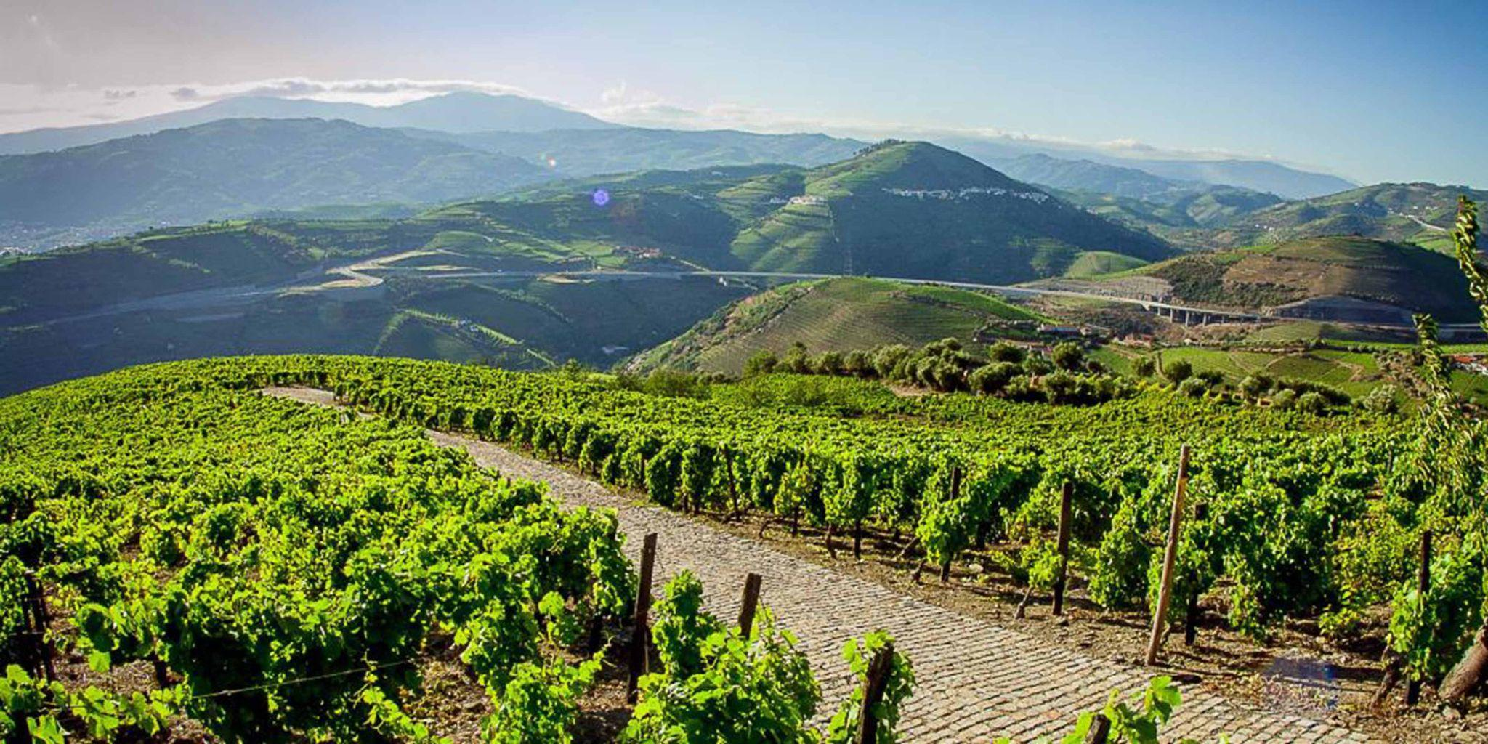
Produced in Portugal
Portugal is home to more than 250 indigenous grape varieties, making it one of the world’s top 10 producers of wine.

Slide 3



On Today’s Menu
01
Our History
02
Our Team’s Mission
03
Chemical Properties
The History of the DataVine 12 Winery
Explains the goal of our project
Factors that contribute to the flavor, aroma, and color of wine

Slide 4
On Today’s Menu
04
The Process
05
Visualizations
06
Contact Us
Explains the data cleaning process and models used
Visualizied models in Tableau
(or not) DataVine 12 will be closed starting April 10 until next harvesting season

Slide 5
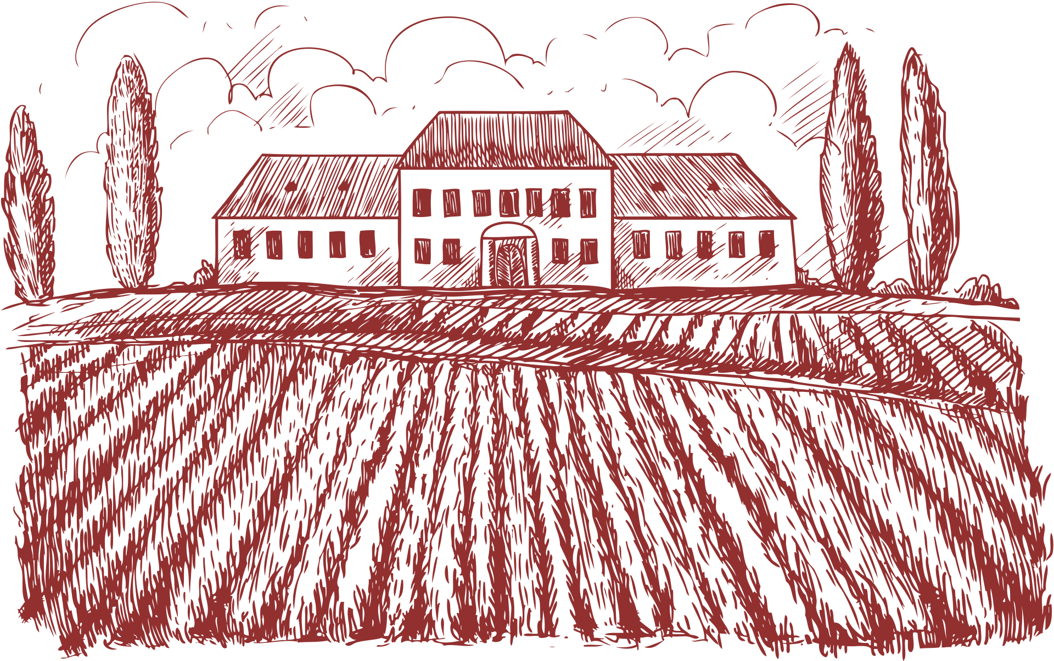
Our History
FoundedOct. ‘24
April’25
DataVine 12
Winery
DataVine 12 Partners
Starting April 10, the winery will be closed to all guests until the next harvesting season
all met online

Slide 6


Our Team’s Mission
The goal of DataVine 12 was to figure out if we can predict wine quality based on its chemical properties?
Wines: Portuguese Reds & Whites
Compared based on fixed and volatile acidity, citric acid, residual sugar, chlorides, free sulfur dioxide, density, pH, sulfates, and alcohol to then determine quality

Slide 7

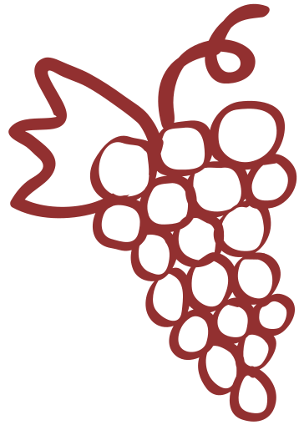
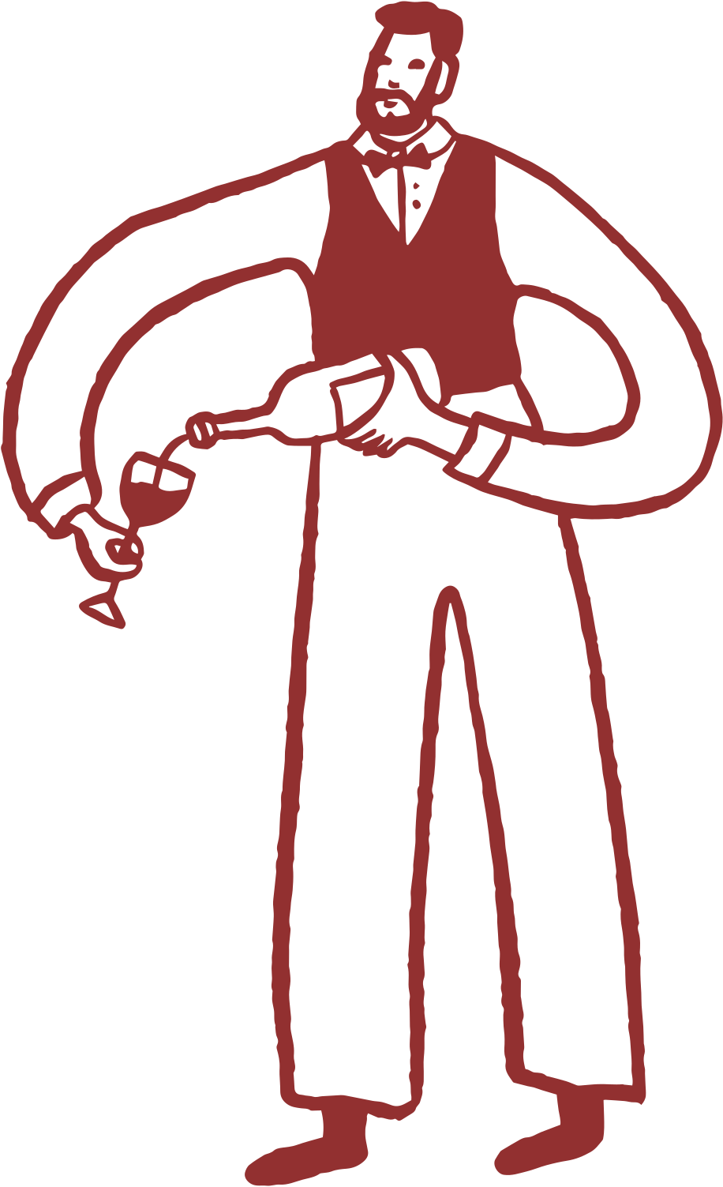


chemical Properties of wine
Fixed/Volatile Acidity
pH
Sulfates
Free Sulfur Dioxide
Scaled: 0-14
0= Very acidic
14=Very basic
Most wines are between 3-4 on the pH scale ;
A wine additive that can contribute to sulfur dioxide gas (S02) levels, which acts as an antimicrobial and antioxidant
The free form of SO2 exists in equilibrium between molecular SO2 (as a dissolved gas) and bisulfite ion
Volatile Acidity-the measure of a wine’s gaseous acids. Contributes to the smell and tastes like vinegar
Fixed Acidity-aka tartaric acid. Doesn’t readily evaporate
Also influences stability and shelf life
Prevents microbial growth and the oxidation of wine

Slide 8
chemical Properties of wine
Citric Acid
Chlorides/ Alcohol
Residual Sugar
Density
The amount of sugar remaining in the wine after fermentation stops
(In terms of water)
depending on the percent alcohol and sugar content
(Alcohol is lighter than water. Density decreases with increased alcohol presence.)
Found in small quantities
Citric acid can add ‘freshness’ and flavor to wine
The amount of salts in wine
it’s rare to find wines with less than 1 gram/liter and wines with greater than 45 grams/liter are considered sweet
Alcohol-the percent alcohol content of the wine

Slide 9
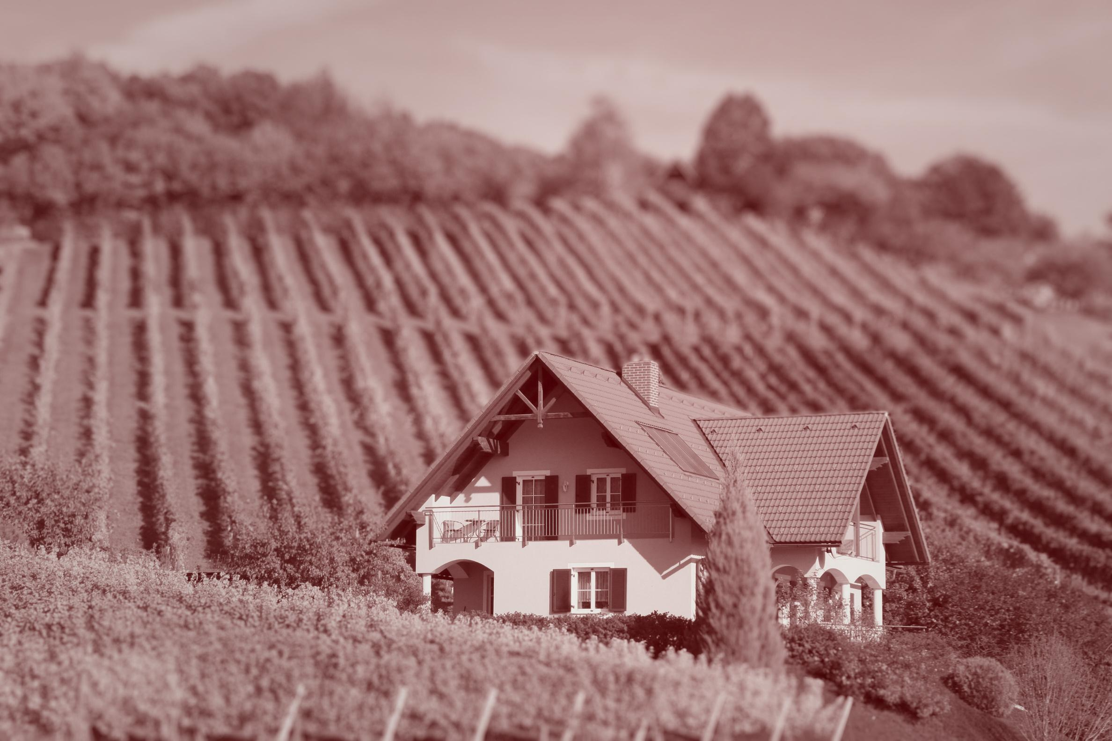

Wine Quality Prediction Using Supervised Learning
• Classification: Low, Medium, High quality
• Dataset: Merged Red and White Wines
• Tools: Python, Spark SQL, Scikit-learn
Notes:
Our notebook focuses on classifying wine quality based on its chemical features. We combined red and white wine datasets and used supervised learning to predict whether a wine falls into low, medium, or high quality. This technique offers an efficient, data-driven way to assess wine quality during production.

Slide 10
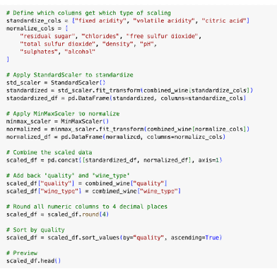
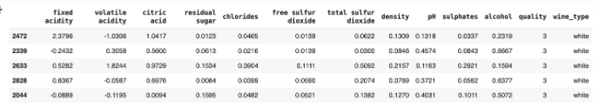
Data Cleaning & Feature Engineering
• Removed nulls, merged datasets
• Applied feature scaling
• Saved as cleaned_wine_data_with_scaling.csv
Notes:
We began by merging red and white wine datasets and cleaned them by handling nulls and formatting the data types. We also standardized all numeric features using scaling techniques so the models would perform optimally.

Slide 11
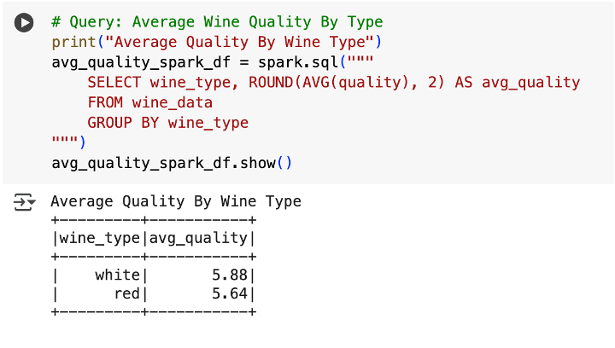
Spark SQL Analysis
• White wines scored slightly higher on average
• Alcohol is a strong indicator of quality
• Density negatively correlates with quality
Notes:
Using Spark SQL, we queried average wine quality by type and discovered that white wines slightly outperform red wines. Alcohol content showed a strong positive relationship with wine quality, while density had a negative one.

Slide 12
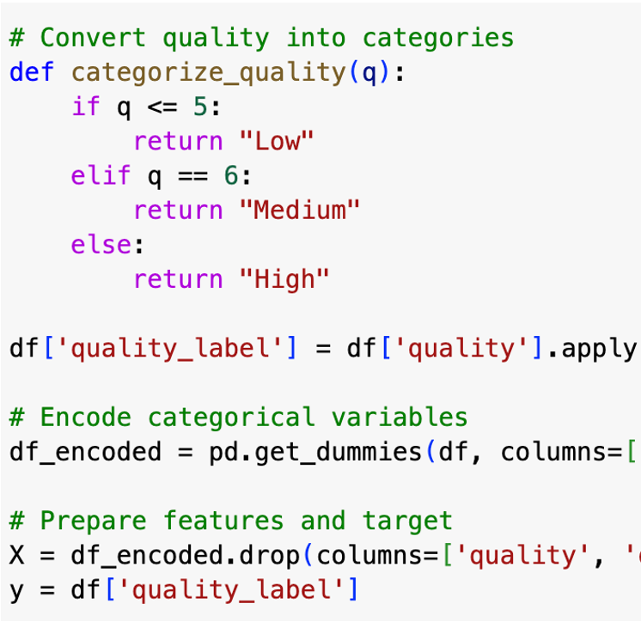
Model Preparation & Label Binning
• Class Encoding:
• 0 = Low (3–5)
• 1 = Medium (6)
• 2 = High (7+)
Notes:
Before training our models, we categorized the wine scores into three classes—low, medium, and high. This label binning transformed the problem into a multiclass classification task rather than using regression.

Slide 13
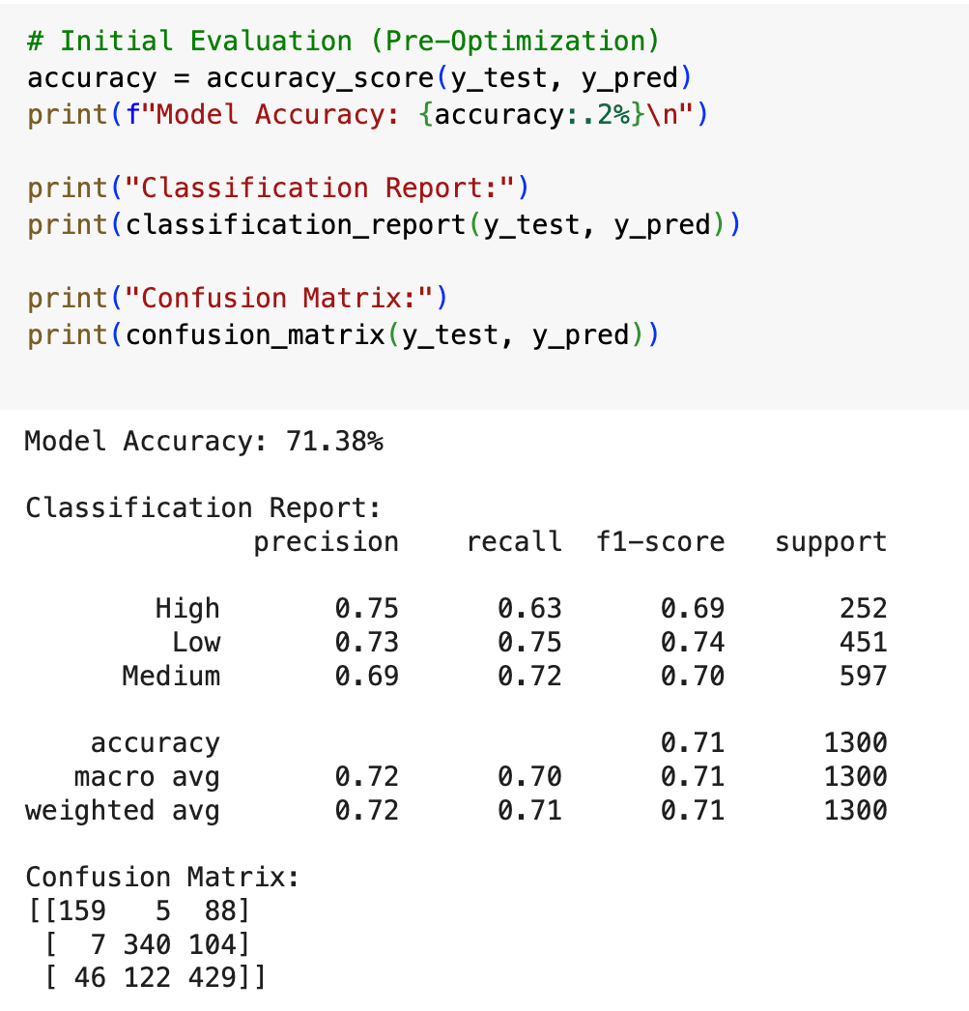
Initial Model Training
• Used Random Forest as baseline model
• Evaluated using precision, recall, F1
Notes:
We first trained a Random Forest Classifier using all features. We also measured precision, recall, and F1-score to validate that the model performs consistently across classes.

Slide 14
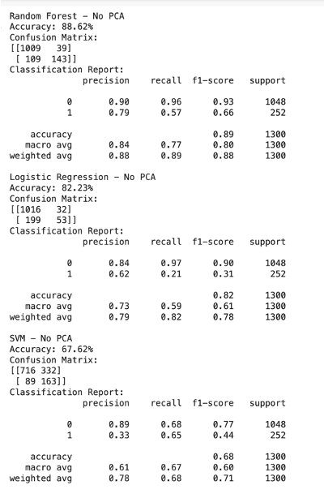
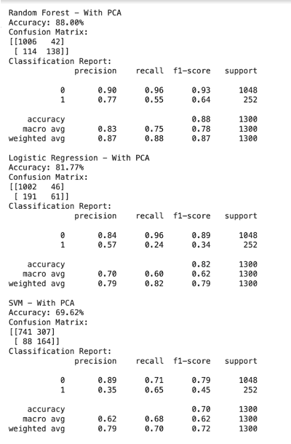
Model Optimization
• Tried Logistic Regression & SVM
• PCA used to reduce dimensions
• Random Forest performed best overall
Notes:
We tested different models including Logistic Regression and SVM, both with and without PCA. PCA helped reduce complexity while maintaining performance. Despite the alternatives, Random Forest still outperformed the others with the best balance of accuracy and interpretability.

Slide 15
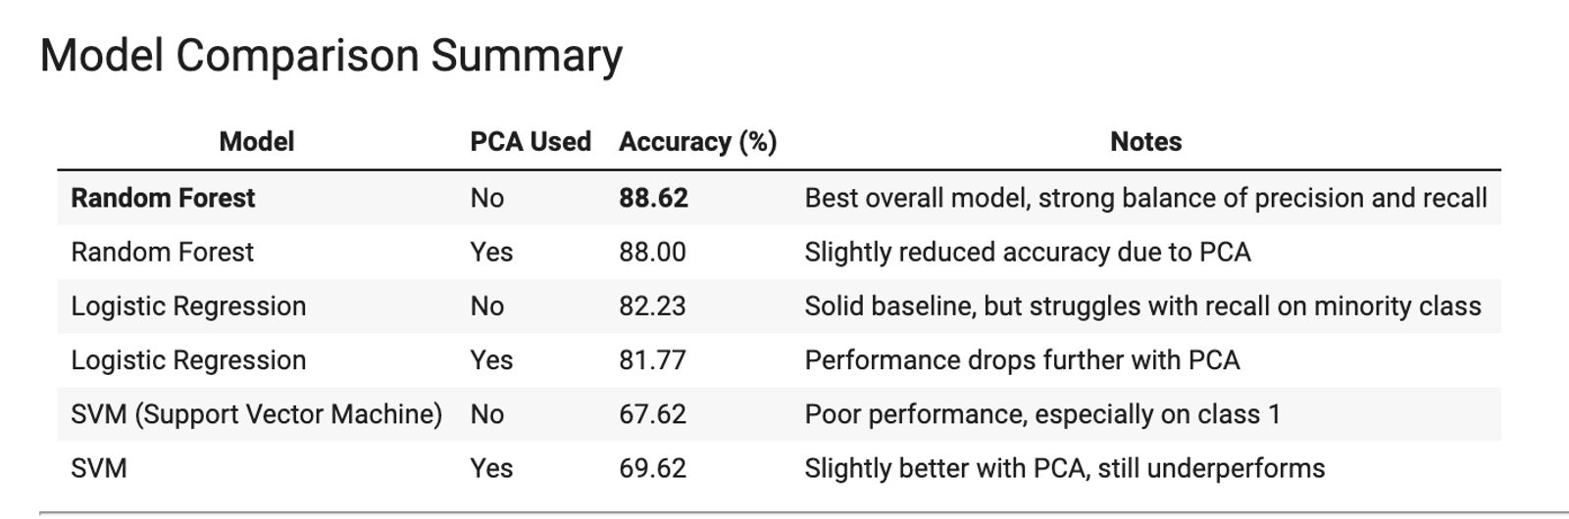
• High precision and recall for most classes
• Model generalizes well to unseen data
• Final accuracy: 88.62%
Model Evaluation
Notes:
We were able to successfully predict wine quality based on chemical properties using machine learning. The Random Forest model without PCA performed best, achieving 88.62% accuracy and exceeding the 75% performance benchmark. PCA helped reduce dimensionality, but Logistic Regression and SVM struggled to identify high-quality wines compared to Random Forest. Overall, the results confirm that chemical features like alcohol, sulphates, and density are strong predictors of wine quality.

Slide 16

Next on the menu: Visualization in Tableau
• Coming up: Feature impact visualizations
• Correlation matrix, class predictions, and wine-type quality breakdown
Notes:
Now that we’ve validated our model, we’ll move on to visualizing our results in Tableau. We’ll explore how features like alcohol, pH, and density influence wine quality across red and white wines.

Slide 17
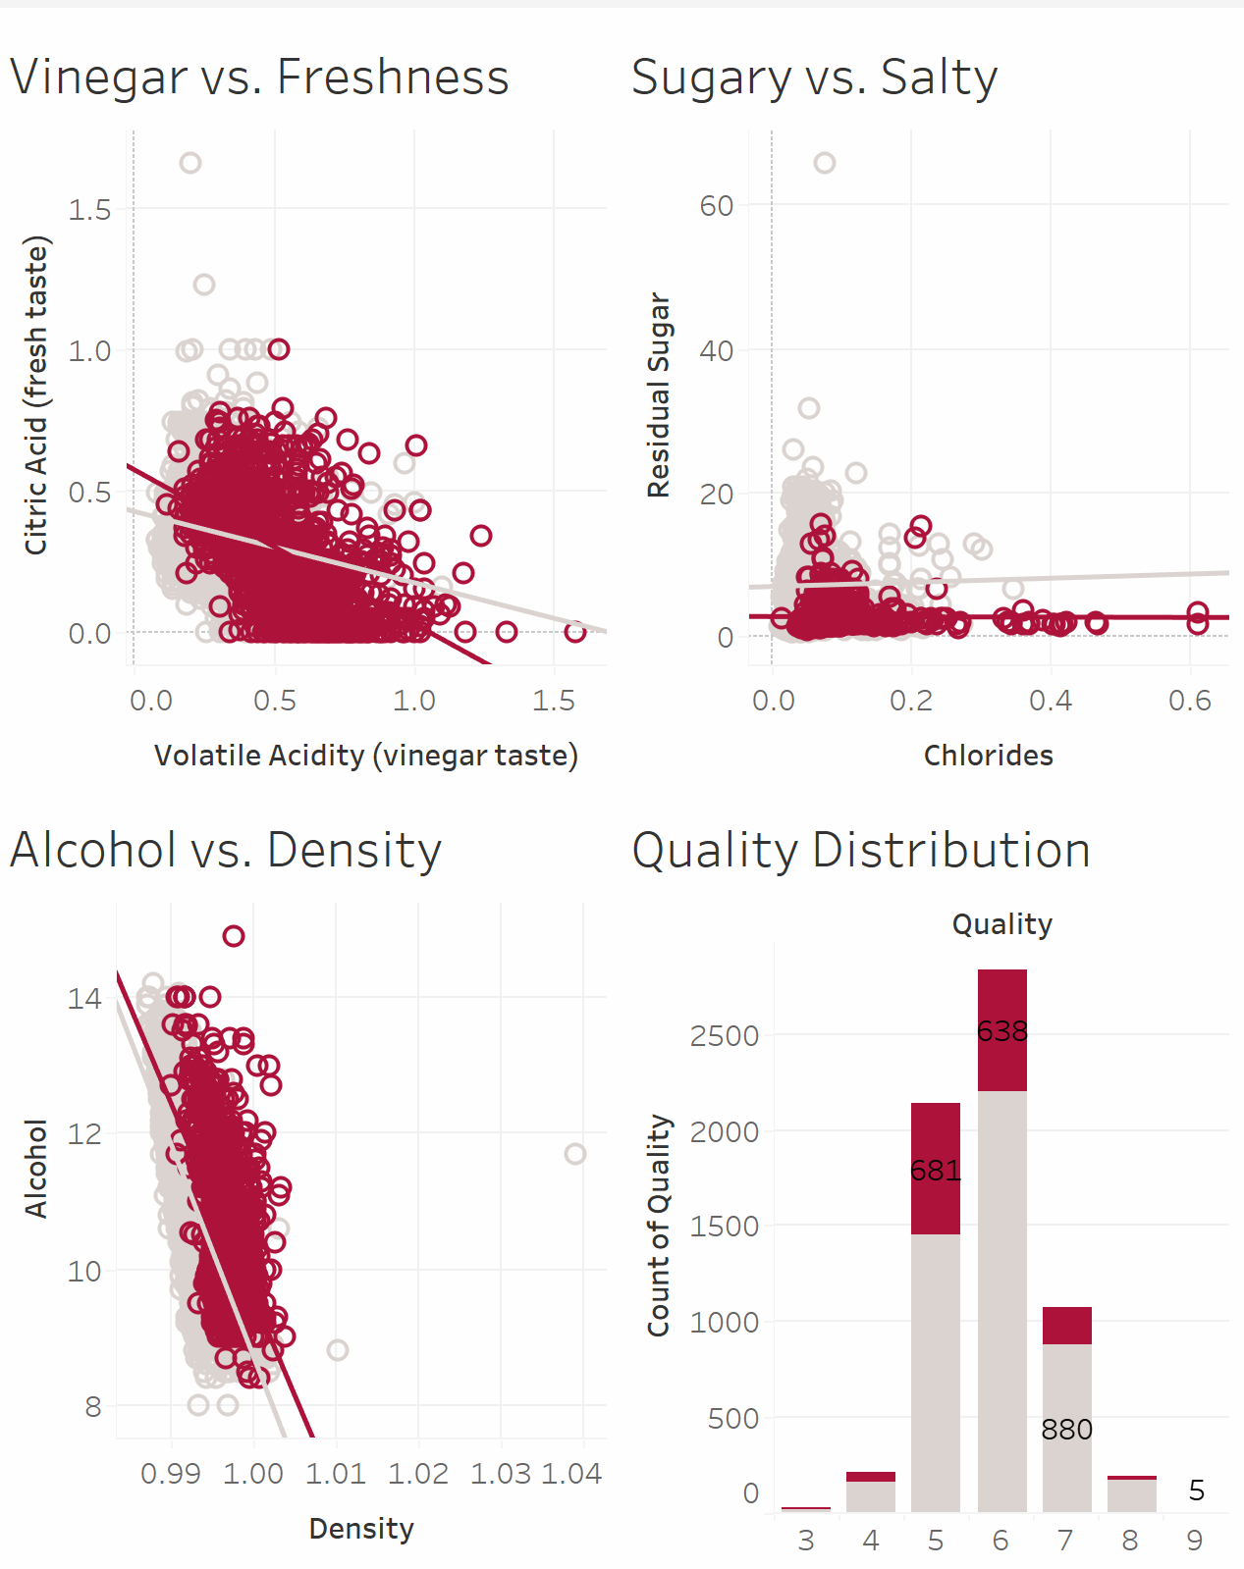
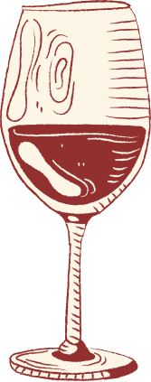
Tableau
.
Wine Quality Prediction Visuals - Team 3 Final Project | Tableau Public
Notes:
Preview of some of the visuals we created on Tableu. To get the full story check out the Tableau link.

Slide 18

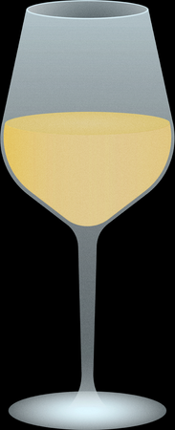


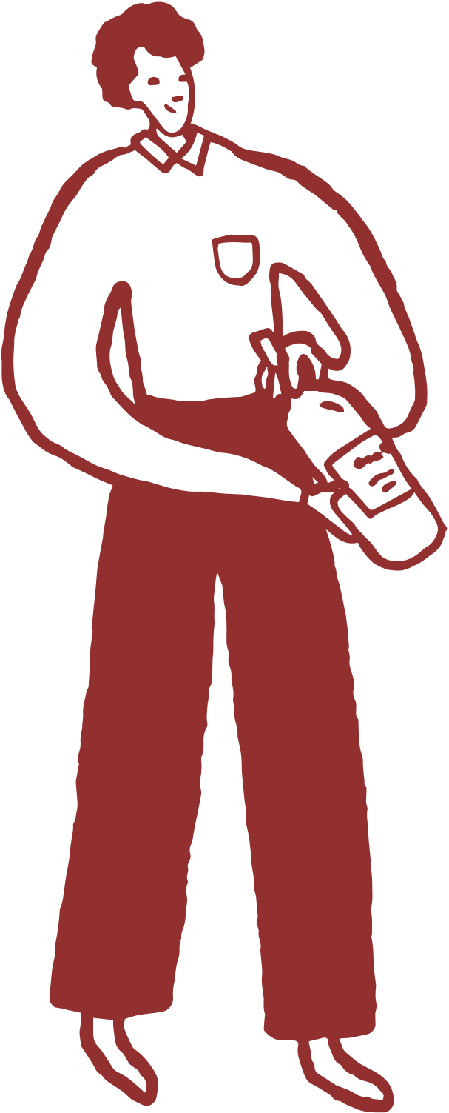




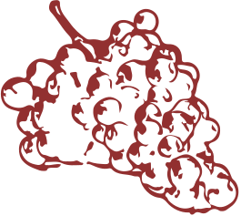
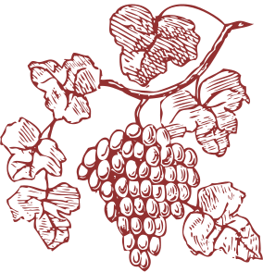
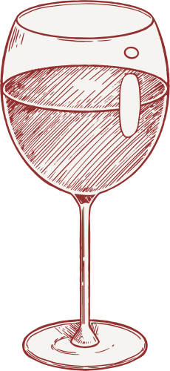
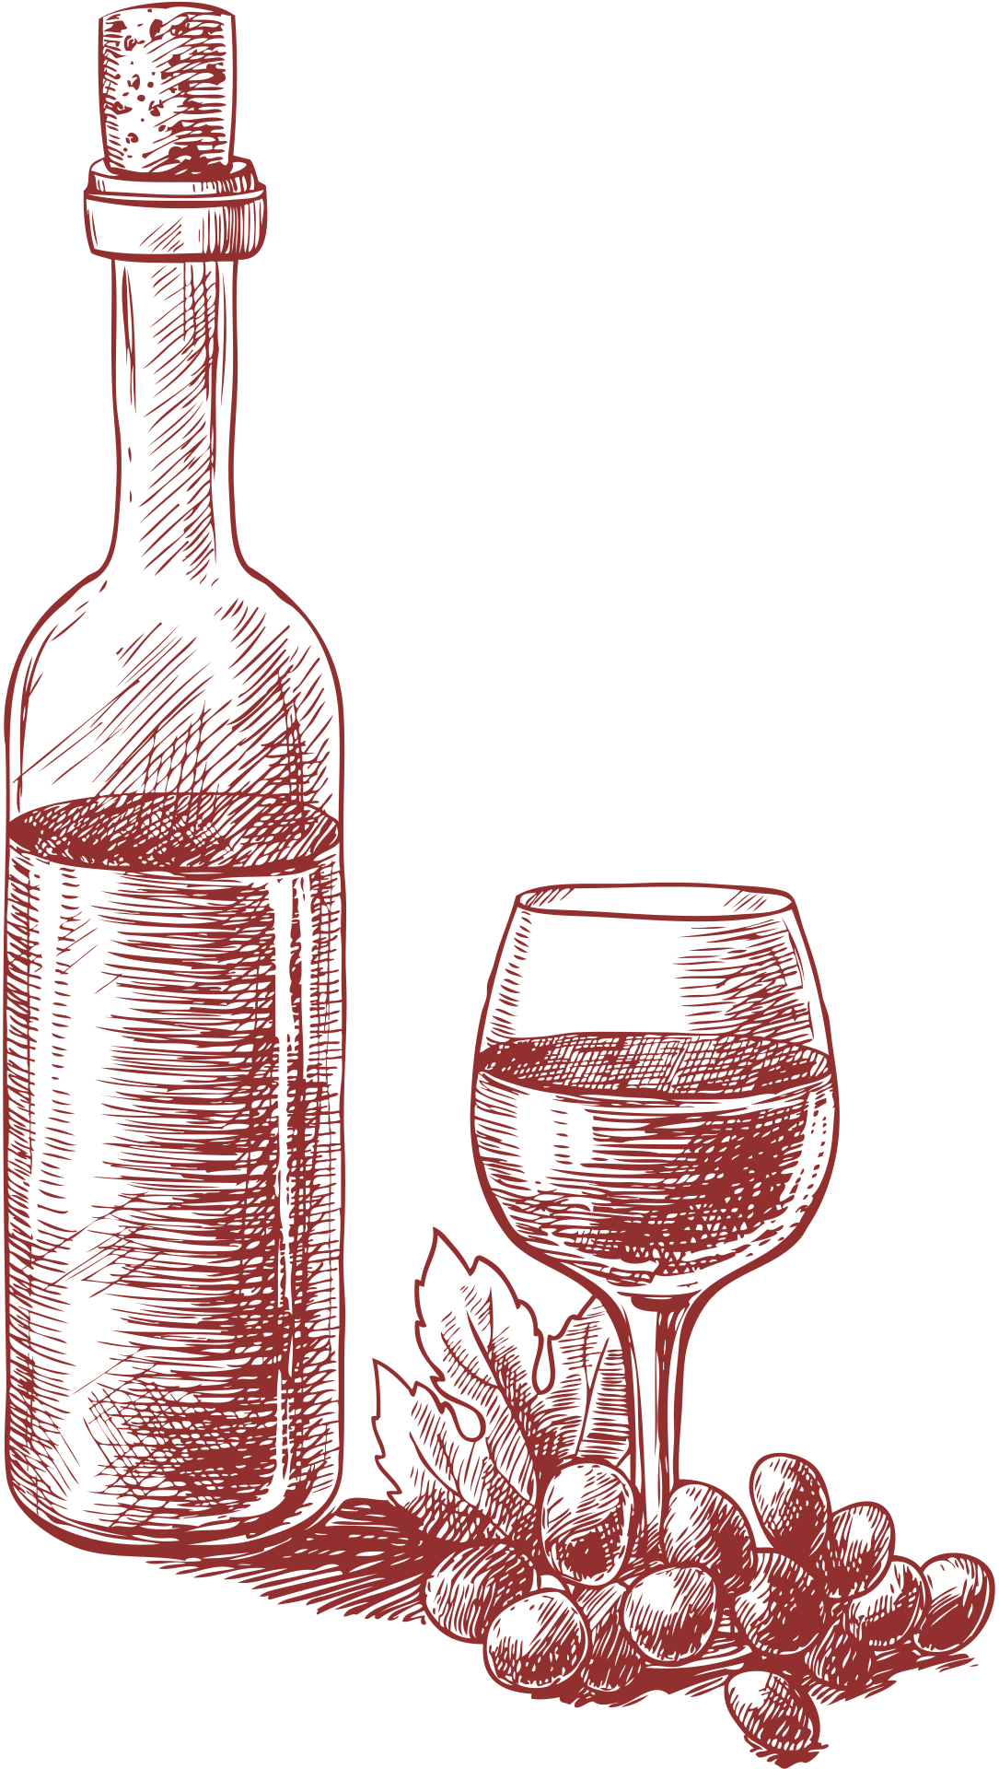
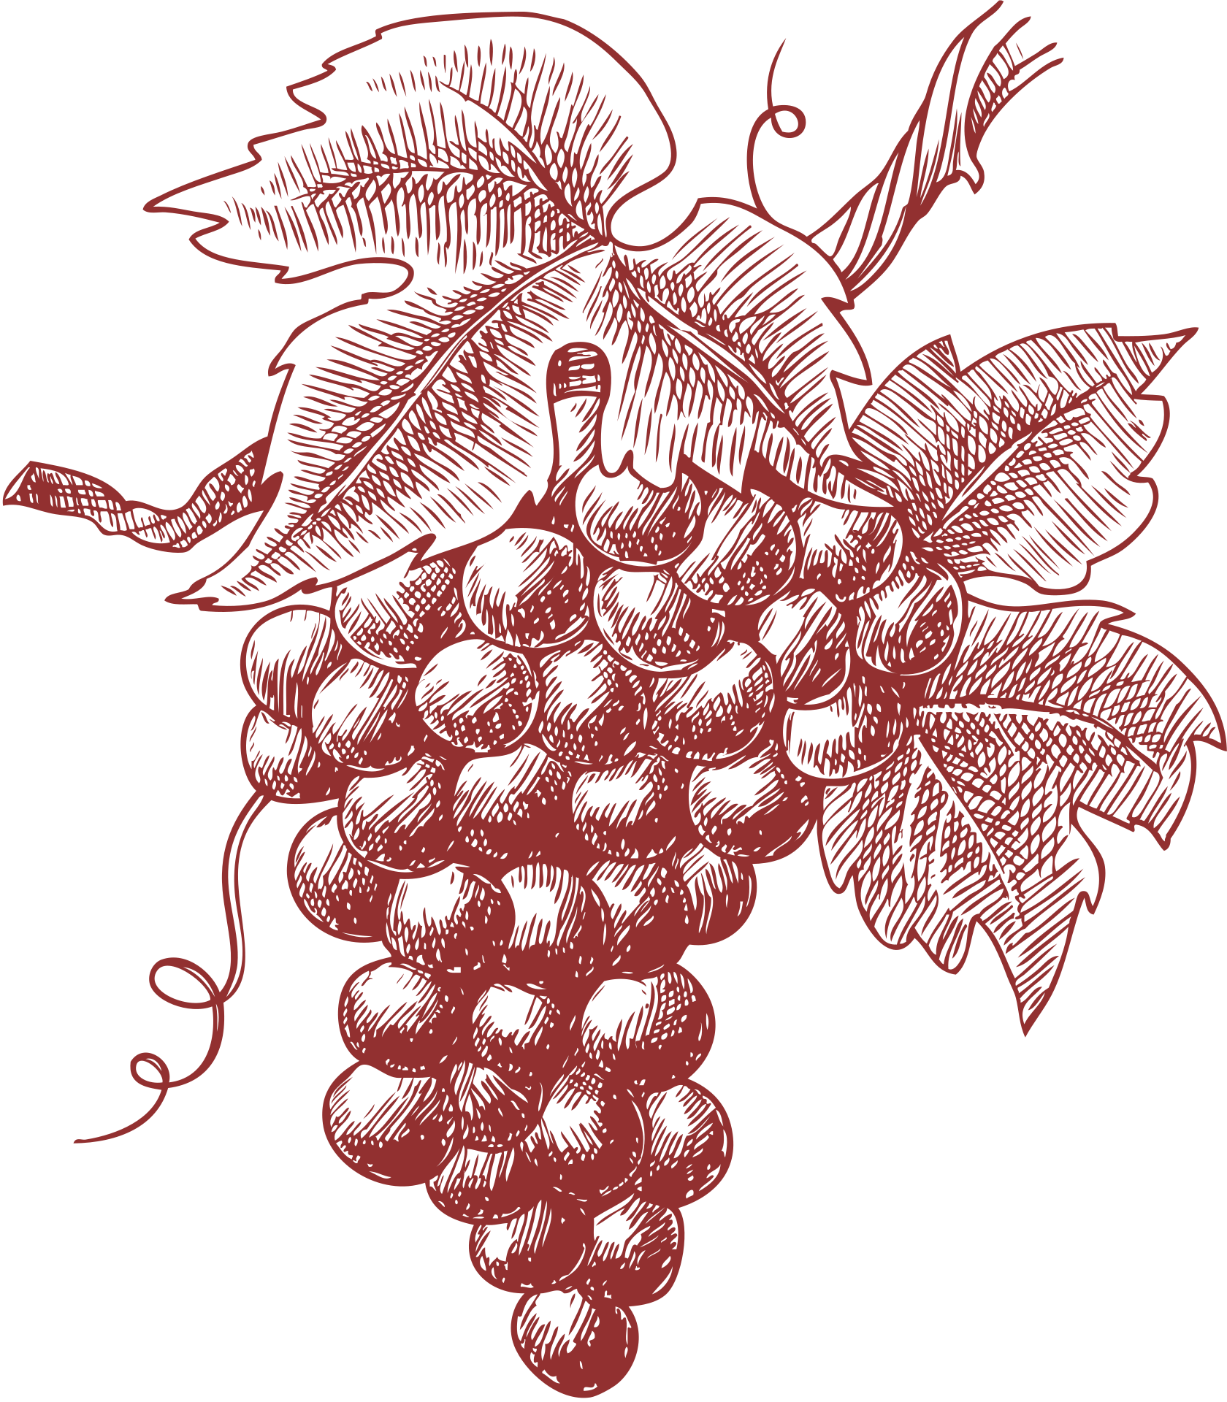

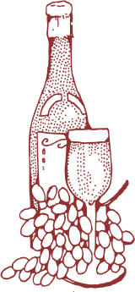
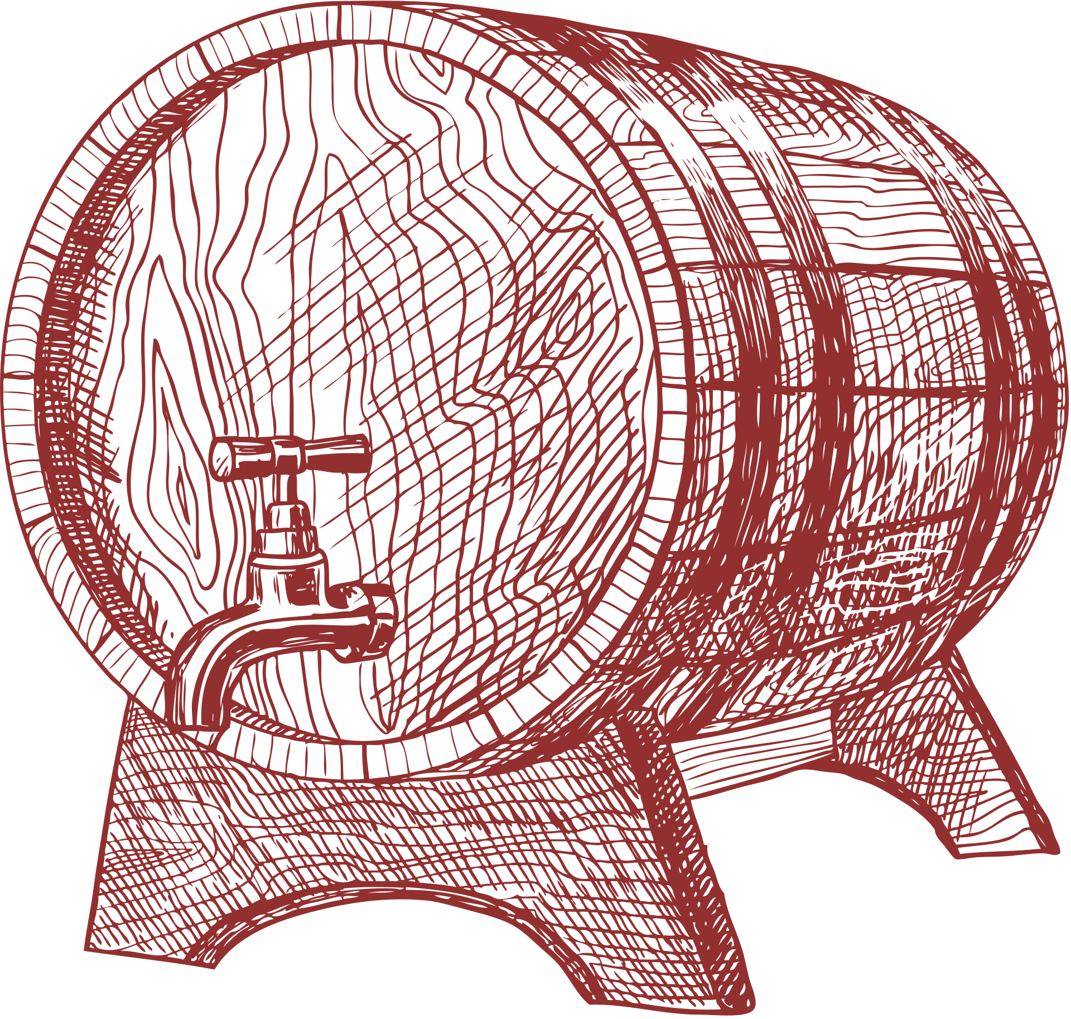
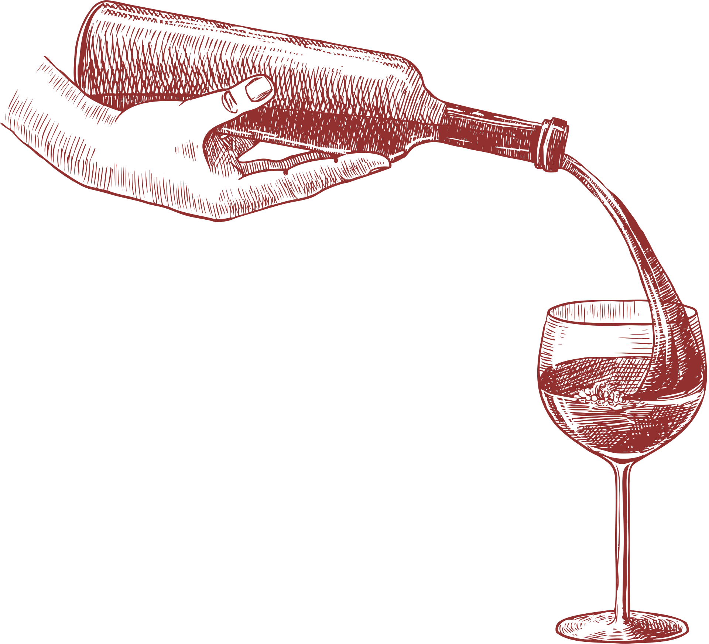
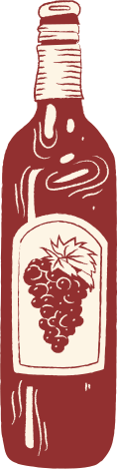
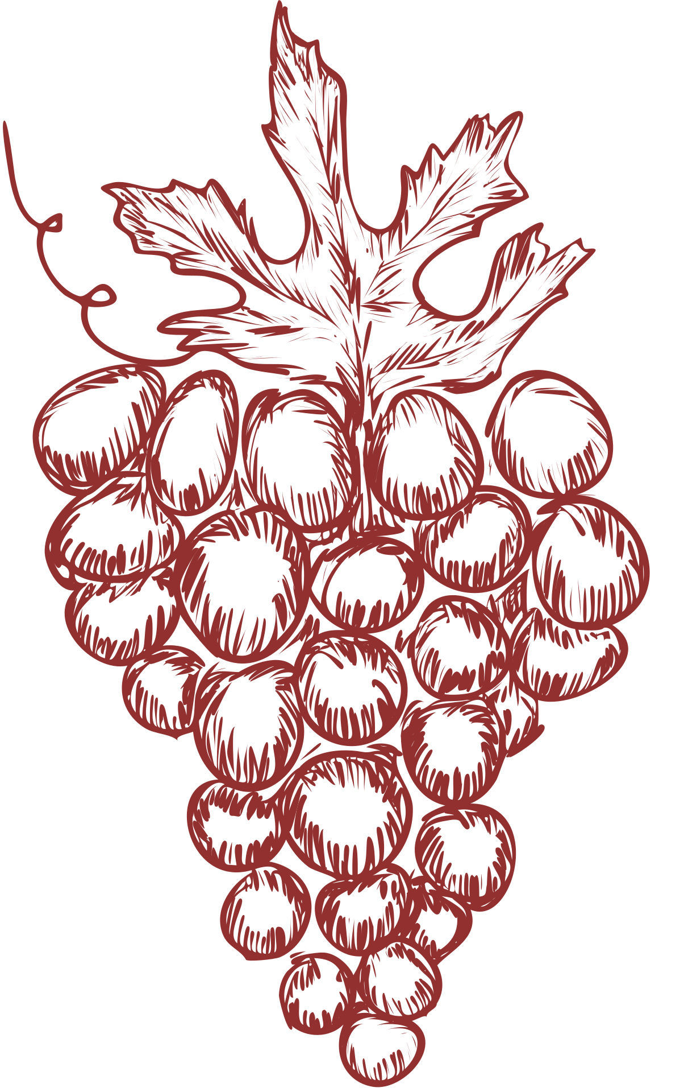







our
sources
https://github.com/alvamag/Team3_Project4/tree/77dc83f774b1955d825d0d8aa0b455e2ea1c4880/Resources

Slide 19

Contact Us
123 Virtual Street
123-456-7890
bestwines@datavinetwelve.com
datavine12
datavinetwelve.com

